Slide 1
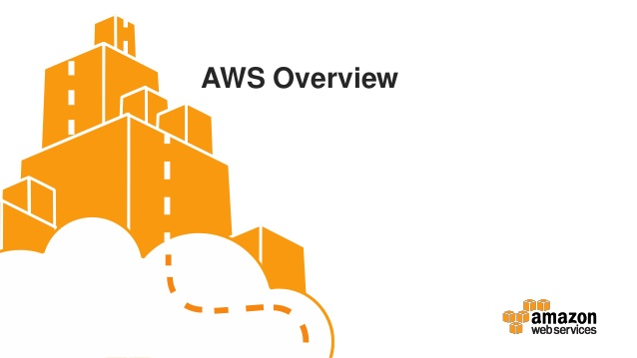
Cloud Computing with AWS

Slide 2

Agenda
Importance of cloud computing
What is Cloud Computing?
Attributes of Cloud Computing
Deployments Models/Service Models
Common Use Cases
What/Why AWS
Building Blocks of AWS
AWS Cloud
- Amazon EC2
- EBS
- S3
- Regions/Availability zone/edge locations
Demo

Slide 3
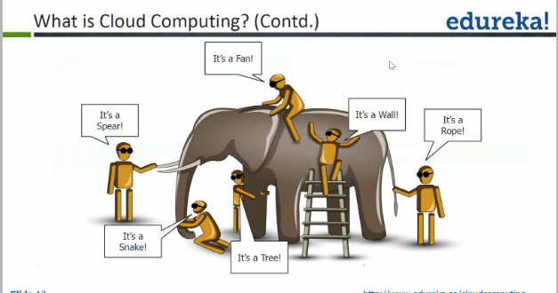

Slide 4

Cloud Computing is a remote virtual pool of on demand shared resources offering compute, storage, network services and Applications that can be rapidly deployed at scale.
Or
Cloud computing means on demand delivery of IT resources via the internet with pay-as-you-go pricing. It provides a solution of IT infrastructure in low cost.

Slide 5
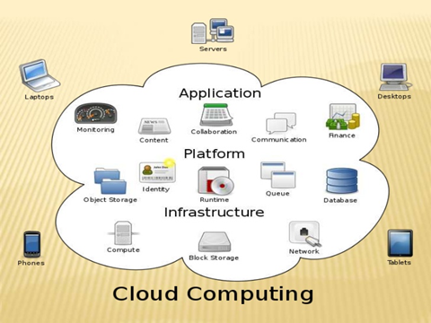

Slide 6


Slide 7
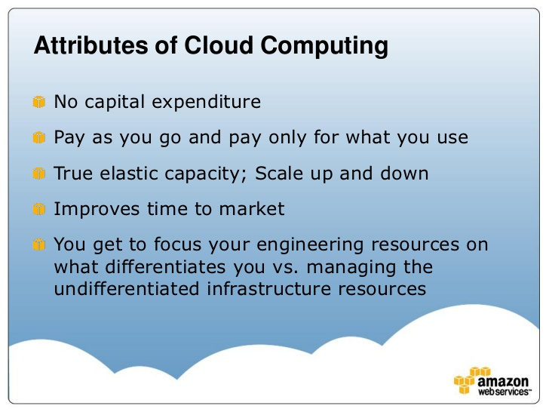

Slide 8
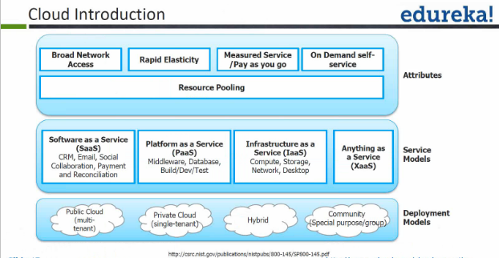

Slide 9
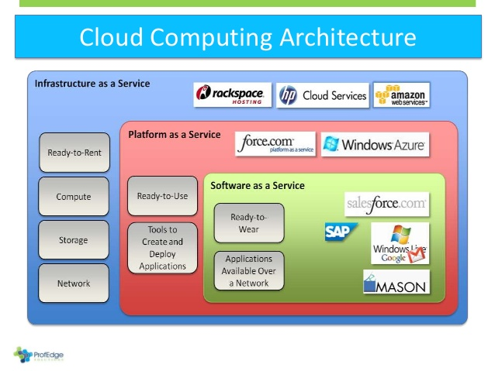

Slide 10
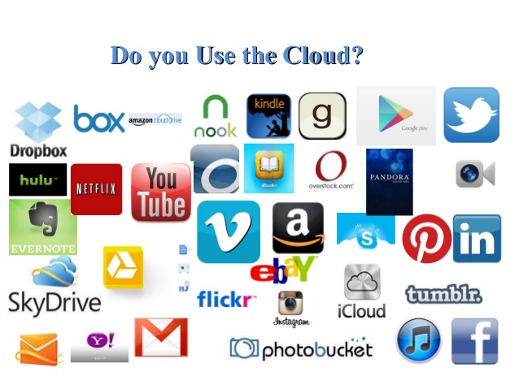

Slide 11
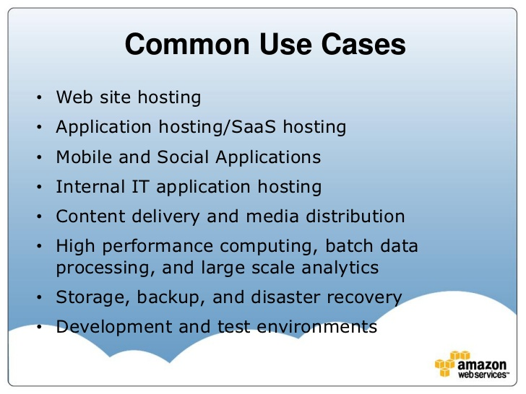

Slide 12
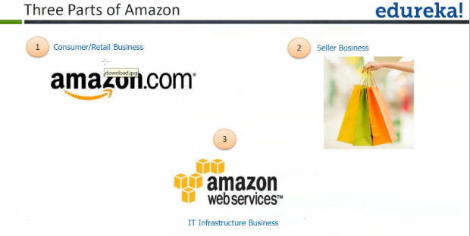
What is AWS?

Slide 13
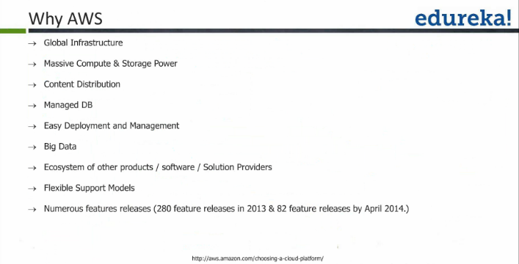

Slide 14
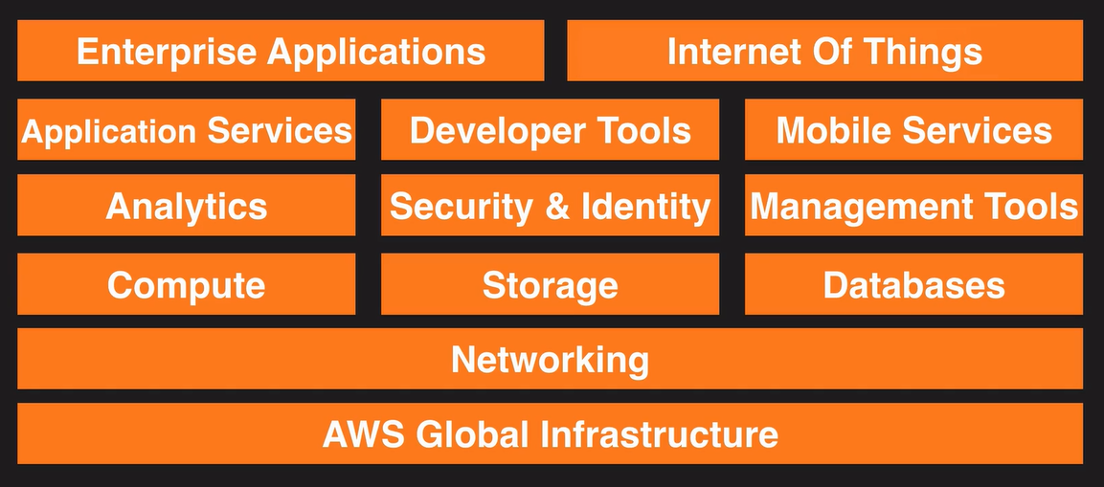
The AWS Platform

Slide 15
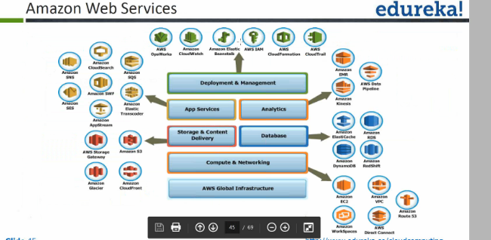

Slide 16
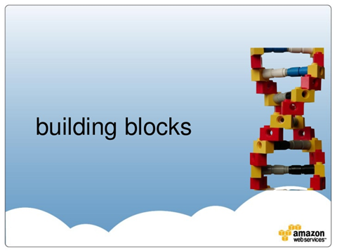

Slide 17
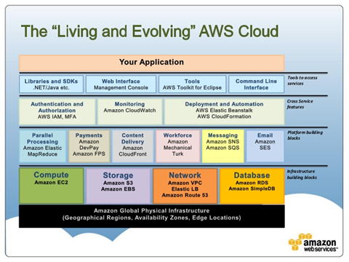

Slide 18
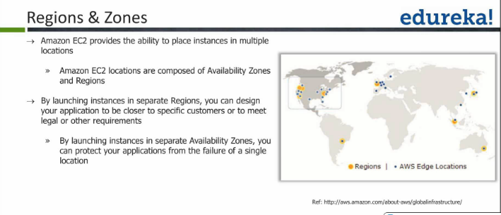

Slide 19
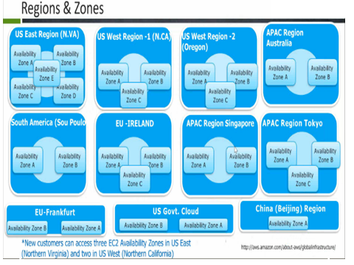

Slide 20
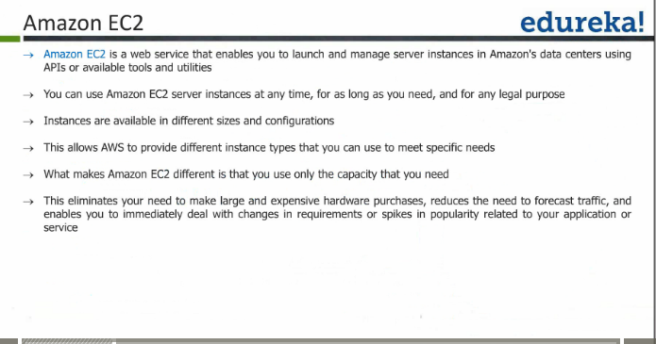

Slide 21
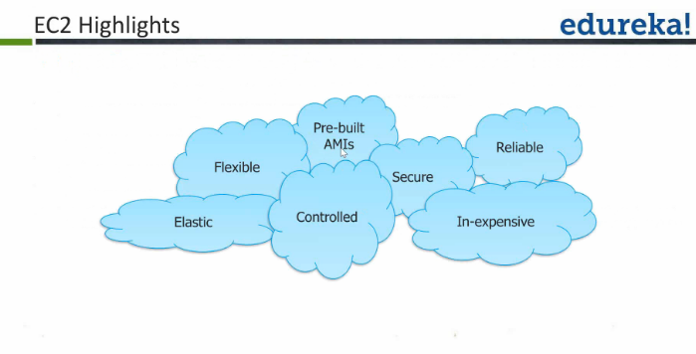

Slide 22
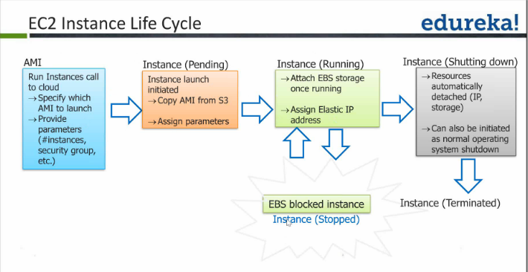

Slide 23
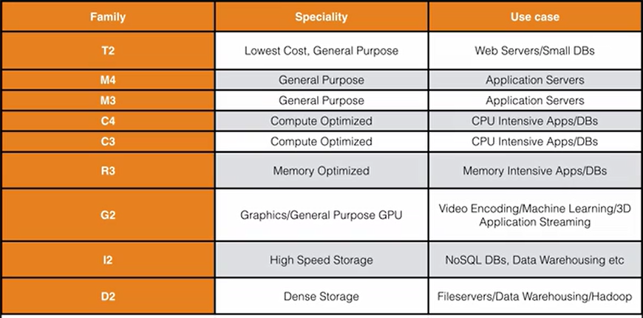
EC2 INSTANCE FAMILY

Slide 24
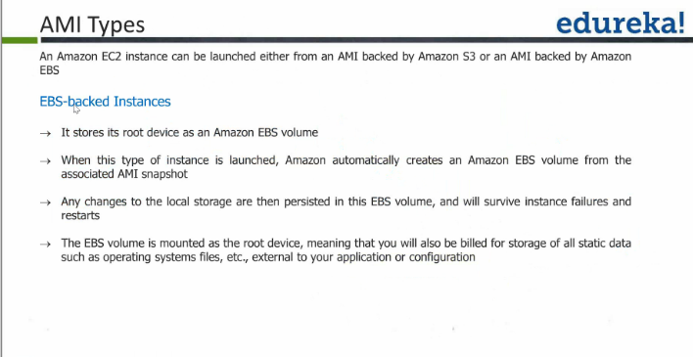

Slide 25
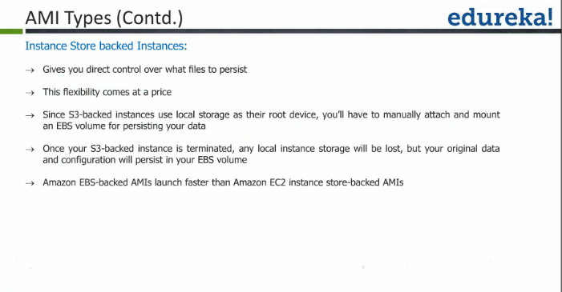

Slide 26
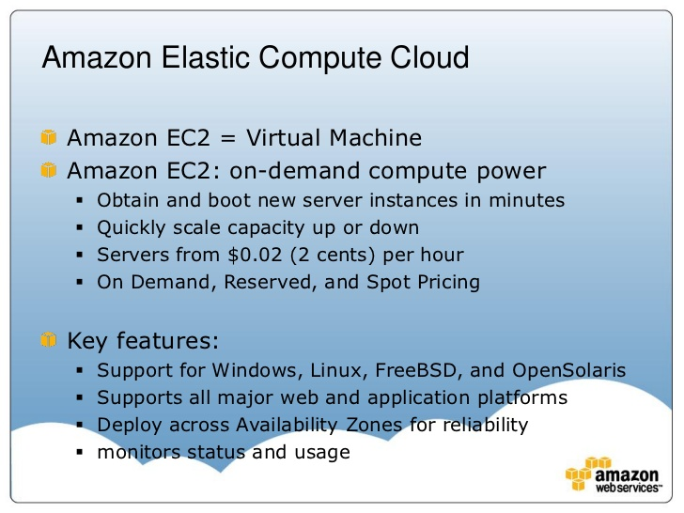

Slide 27
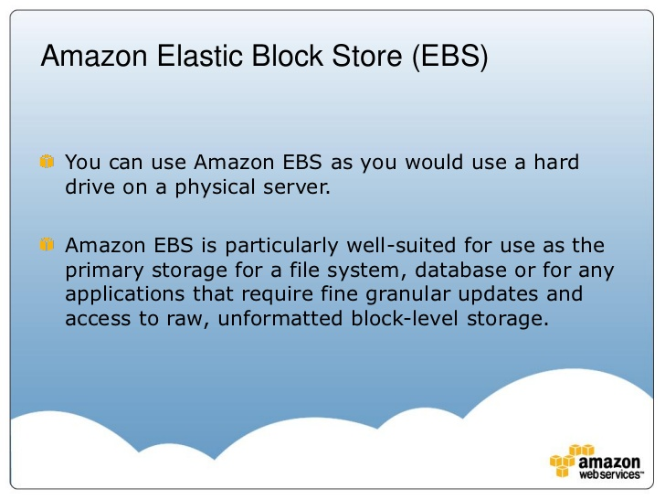

Slide 28
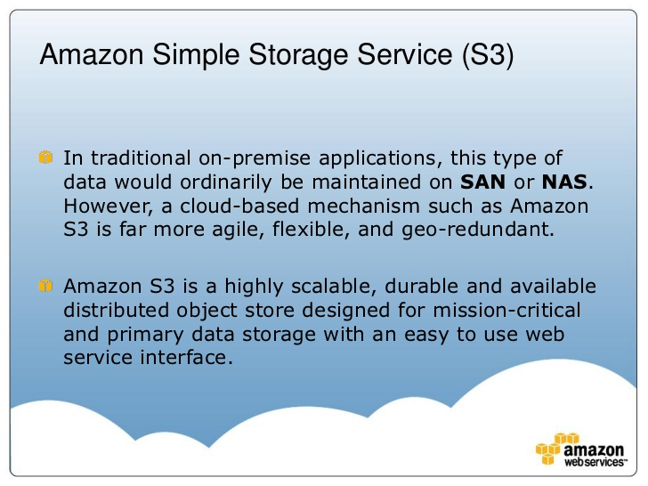

Slide 29
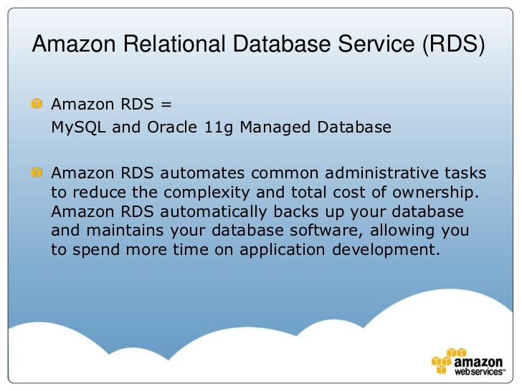

Slide 30
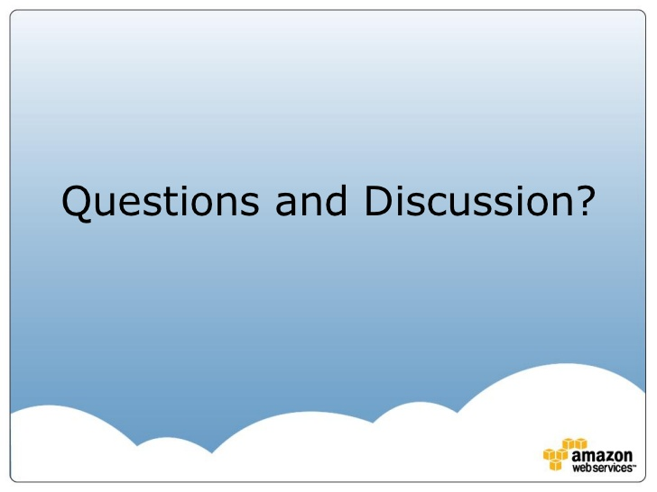
Demonstration

Slide 31


